Slide 1
UNIT 4: Association and Correlation analysis
Basic concepts of frequent pattern and association rule

Slide 2
Summary: What is Data Mining?
Data mining: semi-automatic discovery of interesting patterns from large data sets
Knowledge discovery is a process:
Preprocessing
Data mining
Postprocessing

Slide 3
Summary: Typical KDD Process
Time
based
selection
Operational
Database
Raw
data
Selection
Eval. of
interes-
tingness
Input data
Data mining
Results
Preprocessing
Postprocessing
Cleaned
Verified
Focused
2
Selection
1
3
Utilization
Selected
usable
patterns

Slide 4
Association Rules
Basics
Examples
Apriori Algorithm
FP Growth algorithm
Applications

Slide 5
Market Basket Analysis
Extract information on ppurchasing behavior
"IF buys cold drink and sausage, THEN also by mustard with high probability"
Actionable information: can suggest...
New store layouts and product assortments
Which products to put on promotion
MBA approach is applicable whenever a customer purchases multiple things in proximity
Credit cards
Services of telecommunication companies
Banking services
Medical treatments

Slide 6
Frequent Pattern
Frequent patterns are patterns that appear frequently in a data set. Patterns may be item sets, subsequence or substructures.
Example: A set of items, such as Milk & Butter that appear together in a transaction data set. ( Also called Frequent Item set).
• Frequent item set mining leads to the discovery of associations and correlations among items in large transactional (or) relational data sets.
• This helps in many business decision- making processes like Catalog design, and customer shopping behavior analysis, etc.

Slide 7
Association Rules: Basics
Typical representation formats for association rules:
diapers ⇒ beer [0.5%, 60%]
buys:diapers ⇒ buys:beer [0.5%, 60%]
"IF buys diapers, THEN buys beer in 60% of the cases. Diapers and beer are bought together in 0.5% of the rows in the database."
Other representations (used in Han's book):
buys(x, "diapers") ⇒ buys(x, "beer") [0.5%, 60%]
major(x, "CS") ^ takes(x, "DB") ⇒ grade(x, "A") [1%, 75%]

Slide 8
Association Rules: Basics
diapers ⇒ beer [0.5%, 60%]
"IF buys diapers,
THEN buys beer
in 60% of the cases
in 0.5% of the rows"
1
2
3
4
Antecedent, left-hand side (LHS), body
Consequent, right-hand side (RHS), head
Support, frequency ("in how big part of the data the things in left- and right-hand sides occur together")
Confidence, strength ("if the left-hand side occurs, how likely the right-hand side occurs")

Slide 9
Association Rules: Basics
A=>B
Support: denotes probability that contains both A and B.
Confidence: denotes probability that a transaction containing A also contains B.

Slide 10
Example:
Consider, In a supermarket
Total Transaction: 100.
Bread: 20
So, 20/100 *100 = 20% which is support.
In 20 transaction, butter: 9 transactions
So, 9/20*100 = 45% which is confidence.

Slide 11
Apriori Algorithm
Apriori algorithm is given by R. Agrawal and R. Srikant in 1994 for finding frequent item sets in a dataset for Boolean association rule.
Name of the algorithm is Apriori because it uses prior knowledge of frequent itemset properties.
Apriori algorithm refers to the algorithm which is used to calculate the association rules between objects.
It means how two or more objects are related to one another. In other words, we can say that the Apriori algorithm is an association rule leaning that analyses that people who bought product A also bought product.

Slide 12
Apriori Algorithm
Method:
Initially, scan DB once to get frequent 1-itemset.
Generate length (k+1) candidate itemsets from length k frequent itemsets.
Test the MINIMUM SUPPORT.
Terminate when no frequent or candidate set can be generated

Slide 13
Apriori Algorithm
First, the set of frequent 1-itemsets is found by scanning the database to accumulate the count for each item, and collecting those items that satisfy minimum support. The resulting set is denoted by L1.
Next, L1 is used to find L2 , the set of frequent 2-itemsets, which is used to find L3, and so on, until no more frequent k-itemsets can be found. The finding of each Lk requires one full scan of the database.

Slide 14
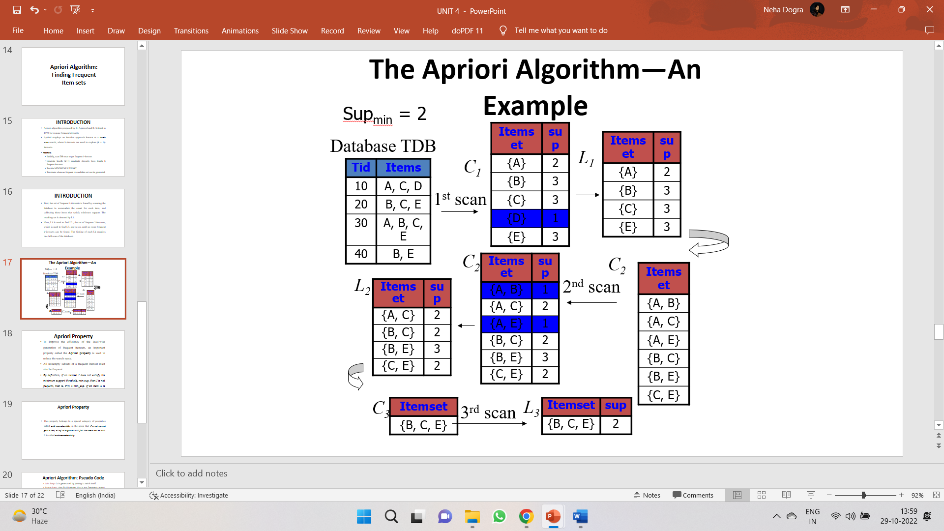
Apriori Algorithm

Slide 15
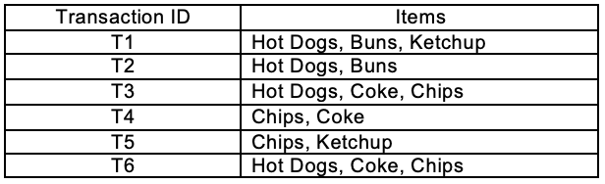
Apriori Algorithm – Example 2
Find the frequent itemsets and generate association rules on this. Assume that minimum support threshold (s = 33.33%) and minimum confident threshold (c = 60%)

Slide 16
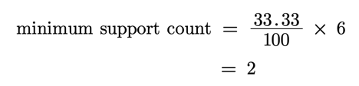
Apriori Algorithm – Example 2
Let’s start,

Slide 17
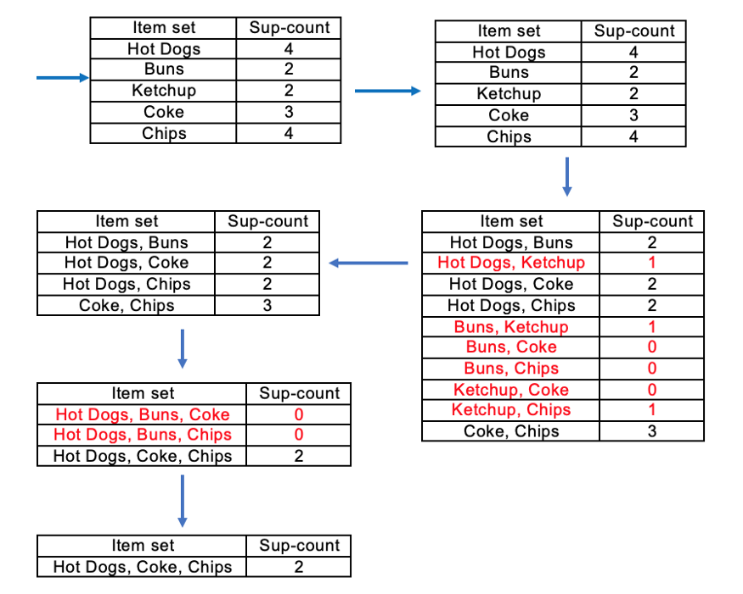
There is only one itemset with minimum support 2. So only one itemset is frequent.

Slide 18
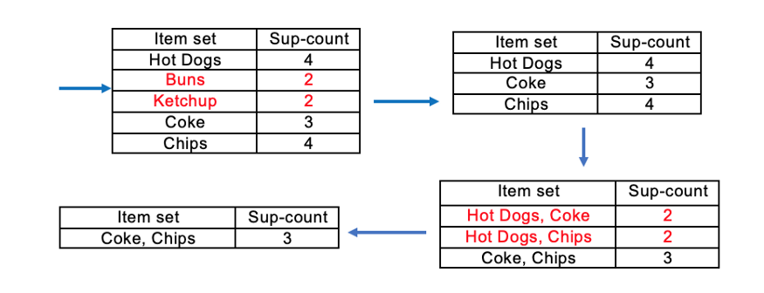
Same example with minimum support =3
Frequent Itemset (I) = {Coke, Chips}

Slide 19
Apriori Algorithm
Advantages of Apriori Algorithm
It is used to calculate large item sets.
Simple to understand and apply.
Disadvantages of Apriori Algorithms
Apriori algorithm is an expensive method to find support since the calculation has to pass through the whole database.
Sometimes, you need a huge number of candidate rules, so it becomes computationally more expensive.

Slide 20
Bottleneck of Frequent-pattern Mining
Multiple database scans are costly
Mining long patterns needs many passes of scanning and generates lots of candidates
To find frequent itemset i₁i₂…i₁₀₀
# of scans: 100
Bottleneck: candidate-generation-and-test
Can we avoid candidate generation?

Slide 21
What is FP Growth Algorithm?
The FP-Growth Algorithm is an alternative way to find frequent item sets without using candidate generations, thus improving performance.
For so much, it uses a divide-and-conquer strategy. The core of this method is the usage of a special data structure named frequent-pattern tree (FP-tree), which retains the item set association information.

Slide 22
Process of FP growth
FP-Growth: allows frequent itemset discovery without candidate itemset generation. Two step approach:
Step 1: Build a compact data structure called the FP-tree
Built using 2 passes over the data-set.
Step 2: Extracts frequent itemsets directly from the FP-tree

Slide 23
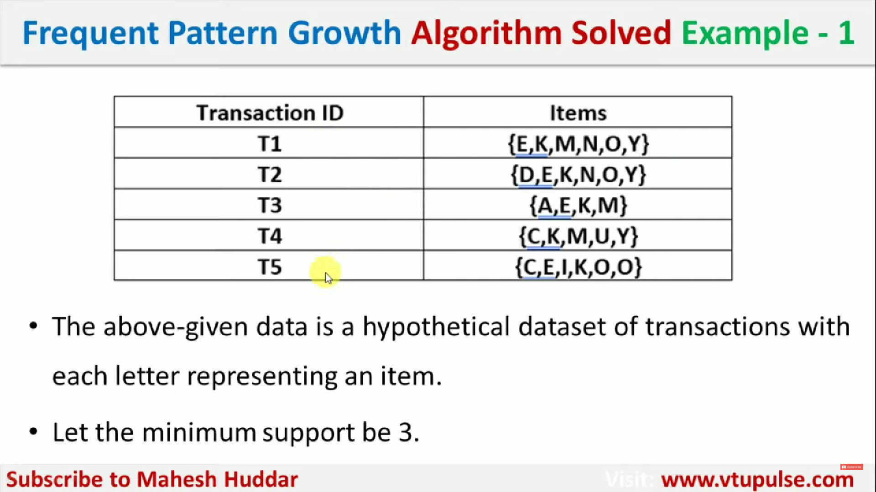

Slide 24
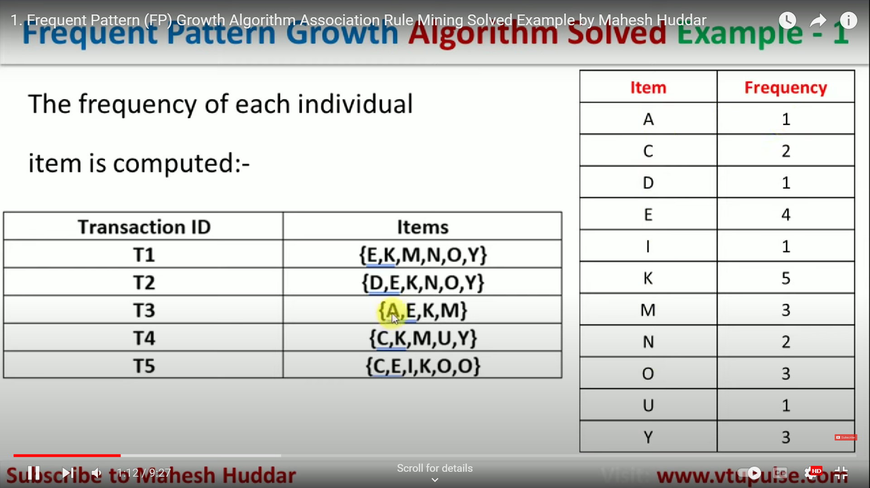

Slide 25
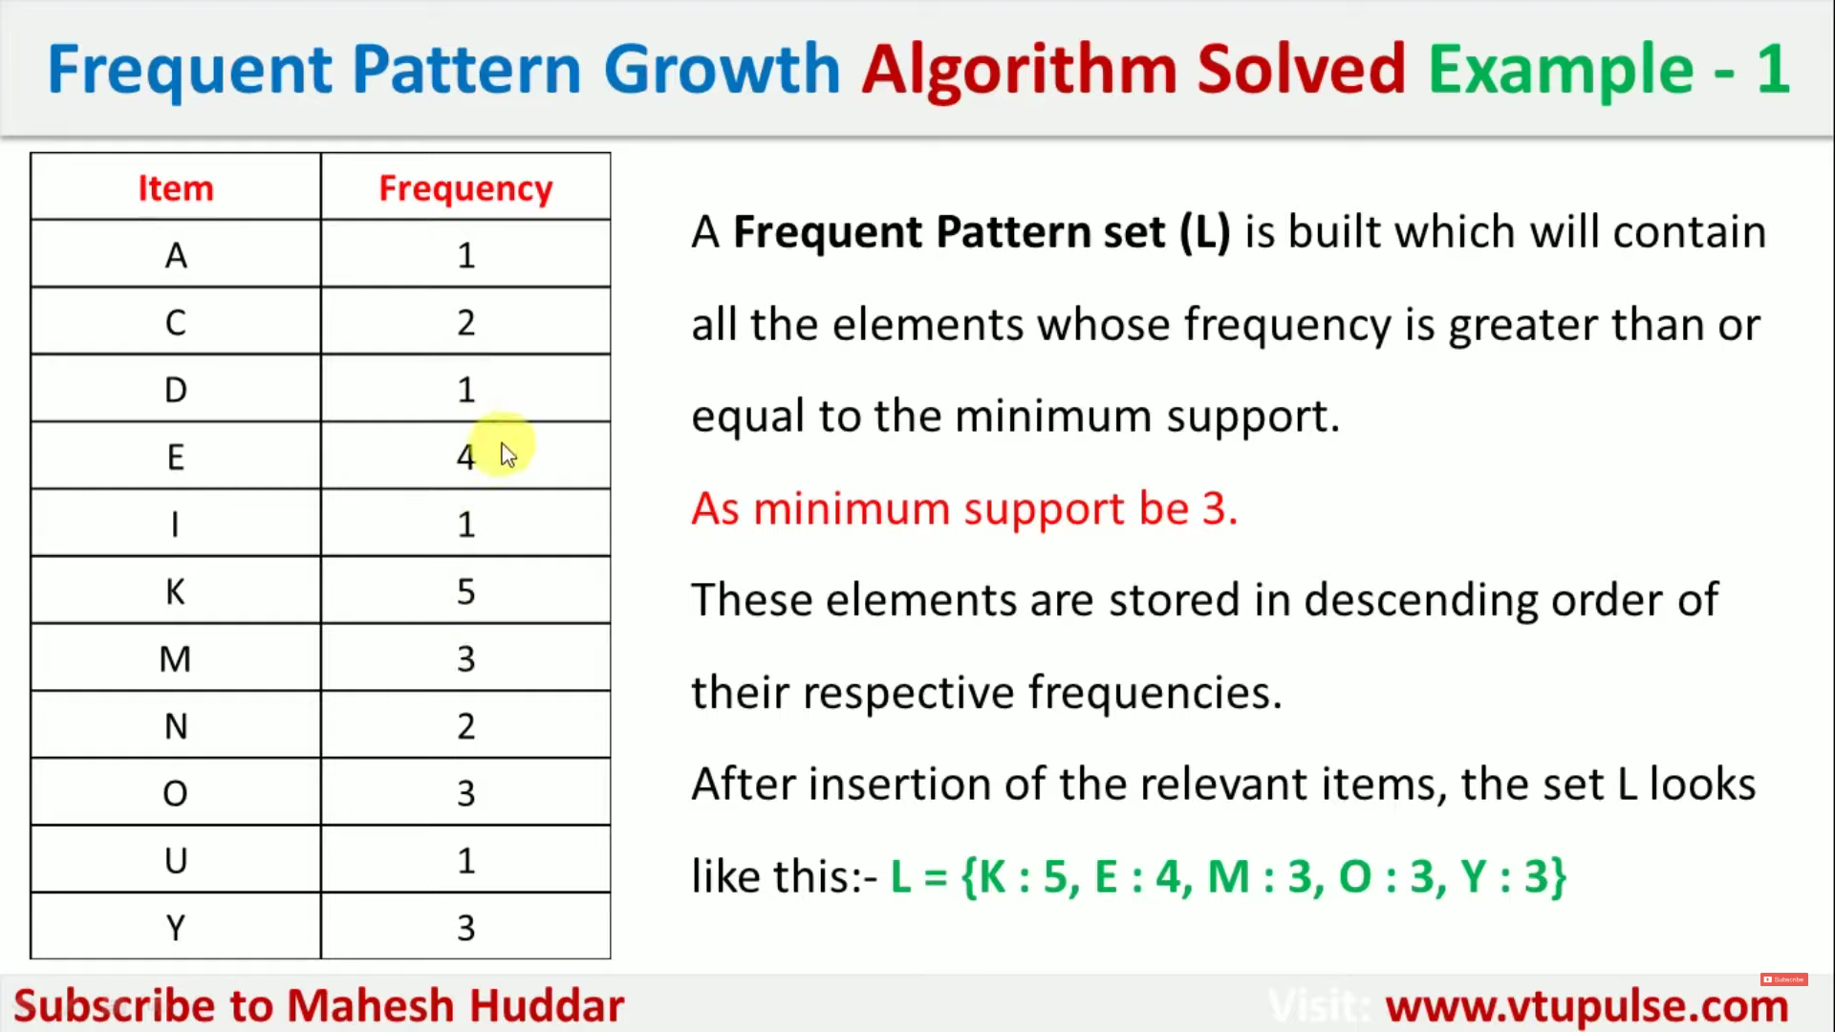

Slide 26
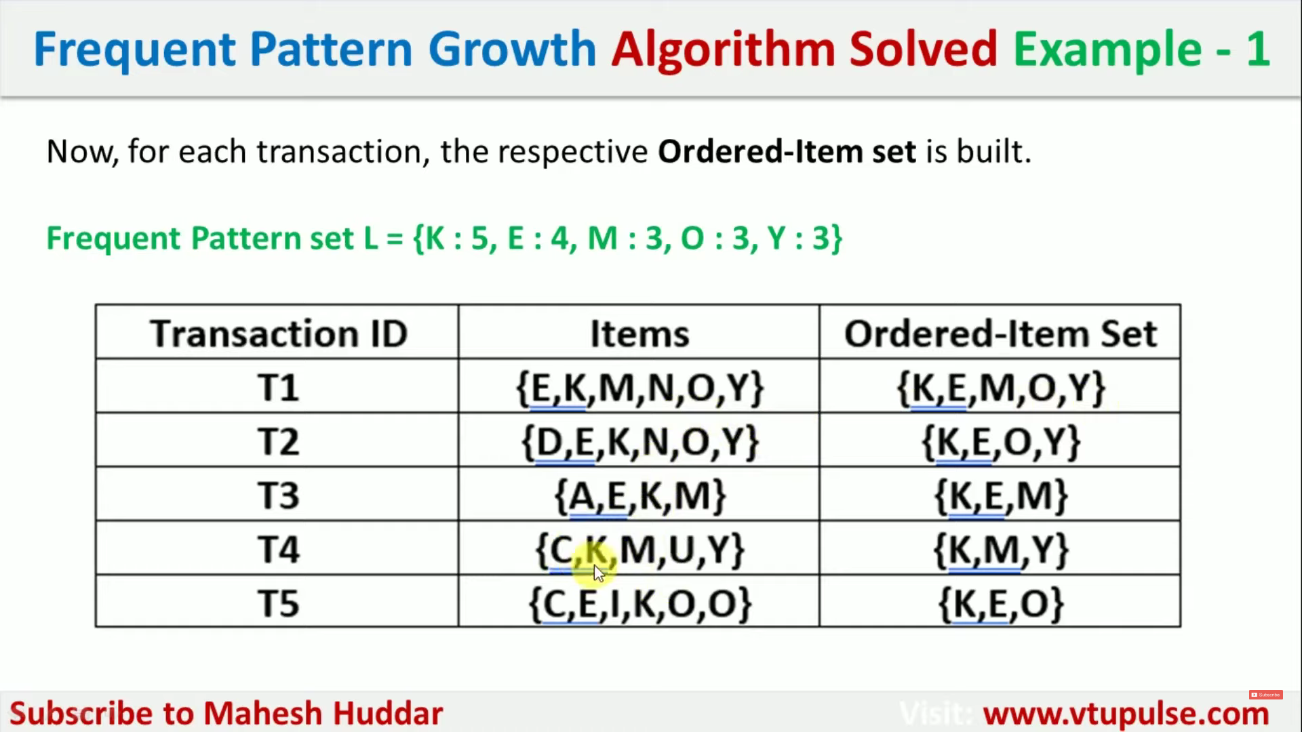

Slide 27
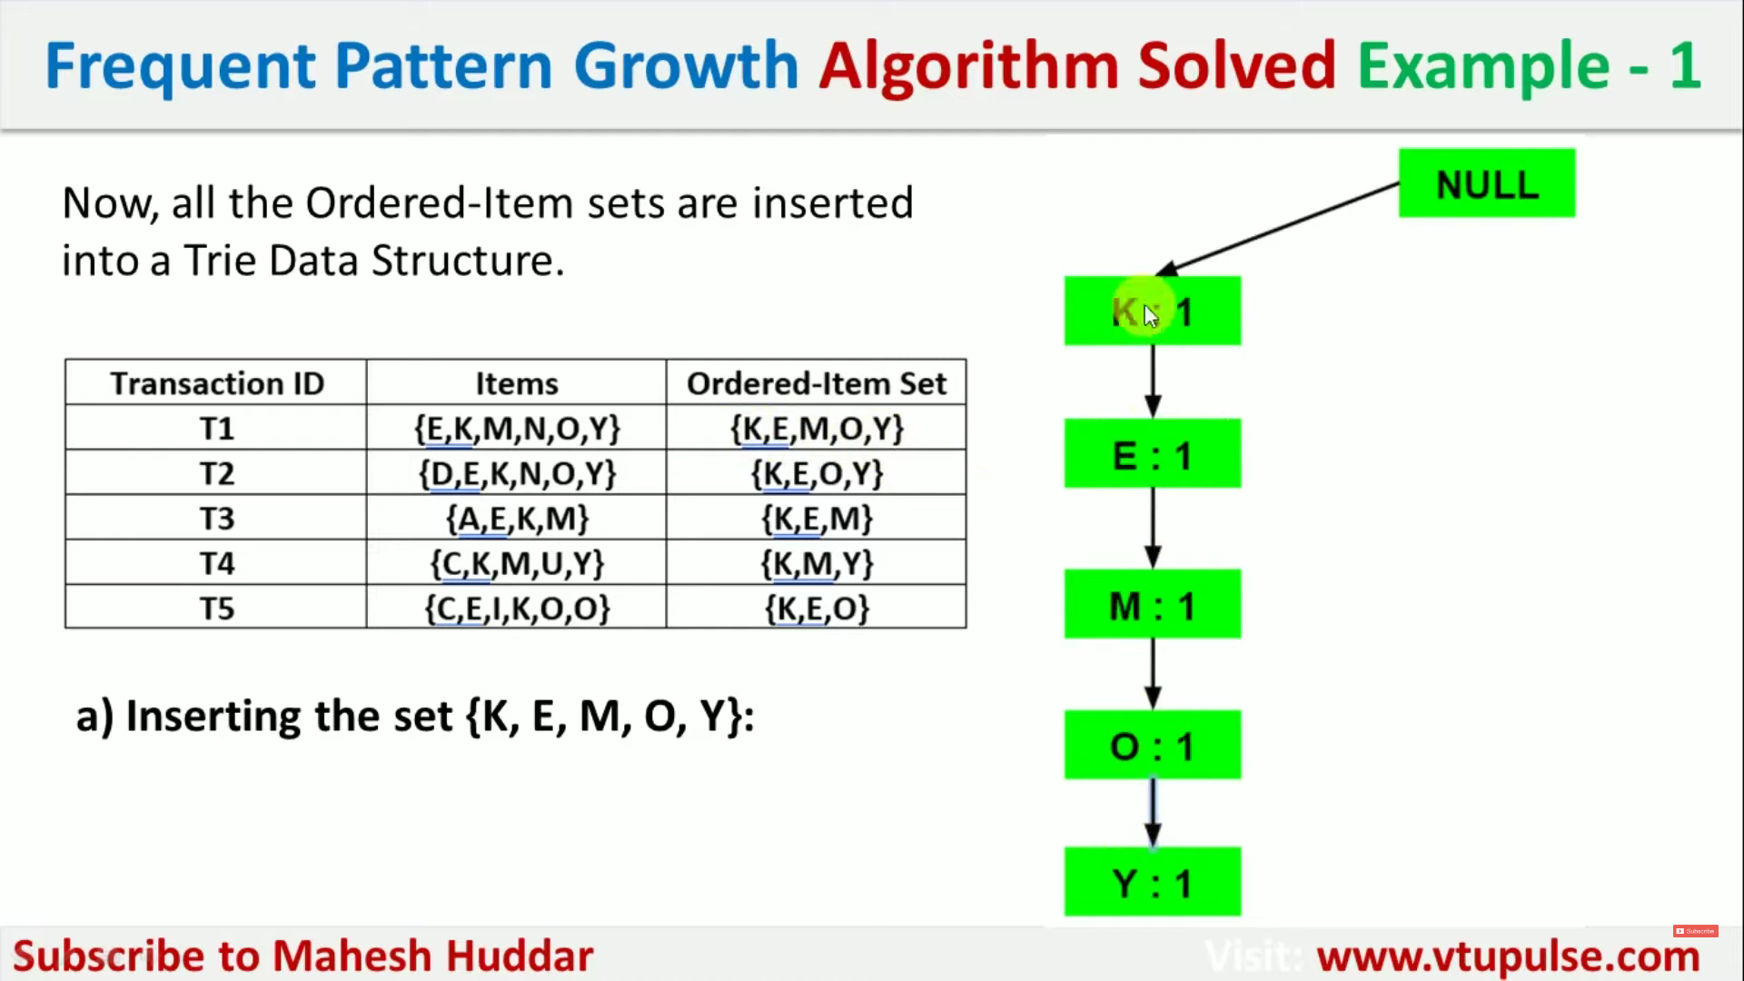

Slide 28
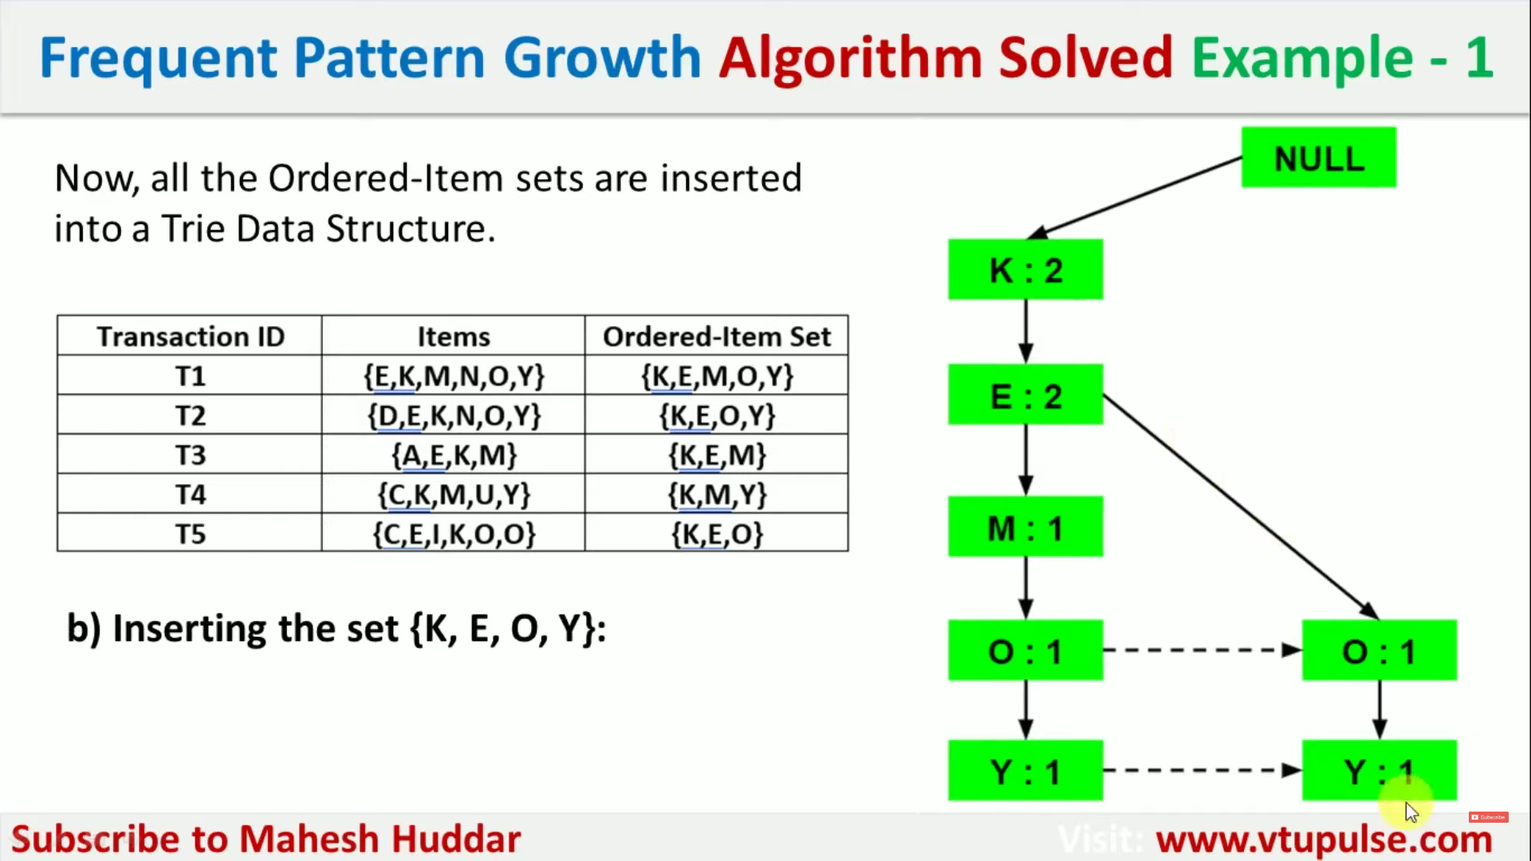

Slide 29
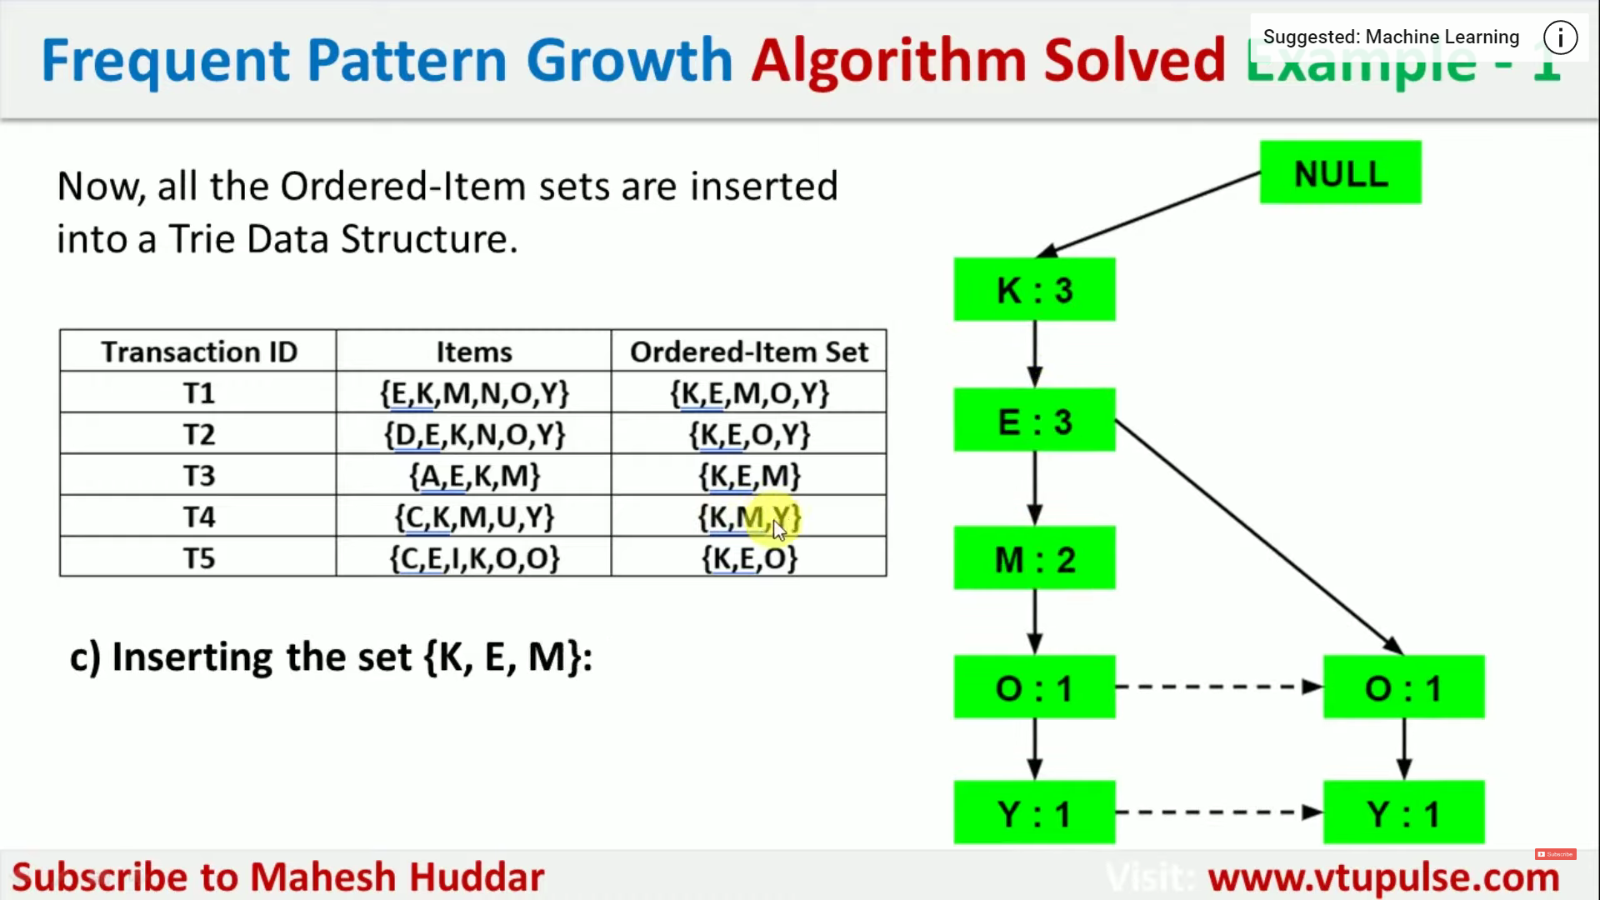

Slide 30
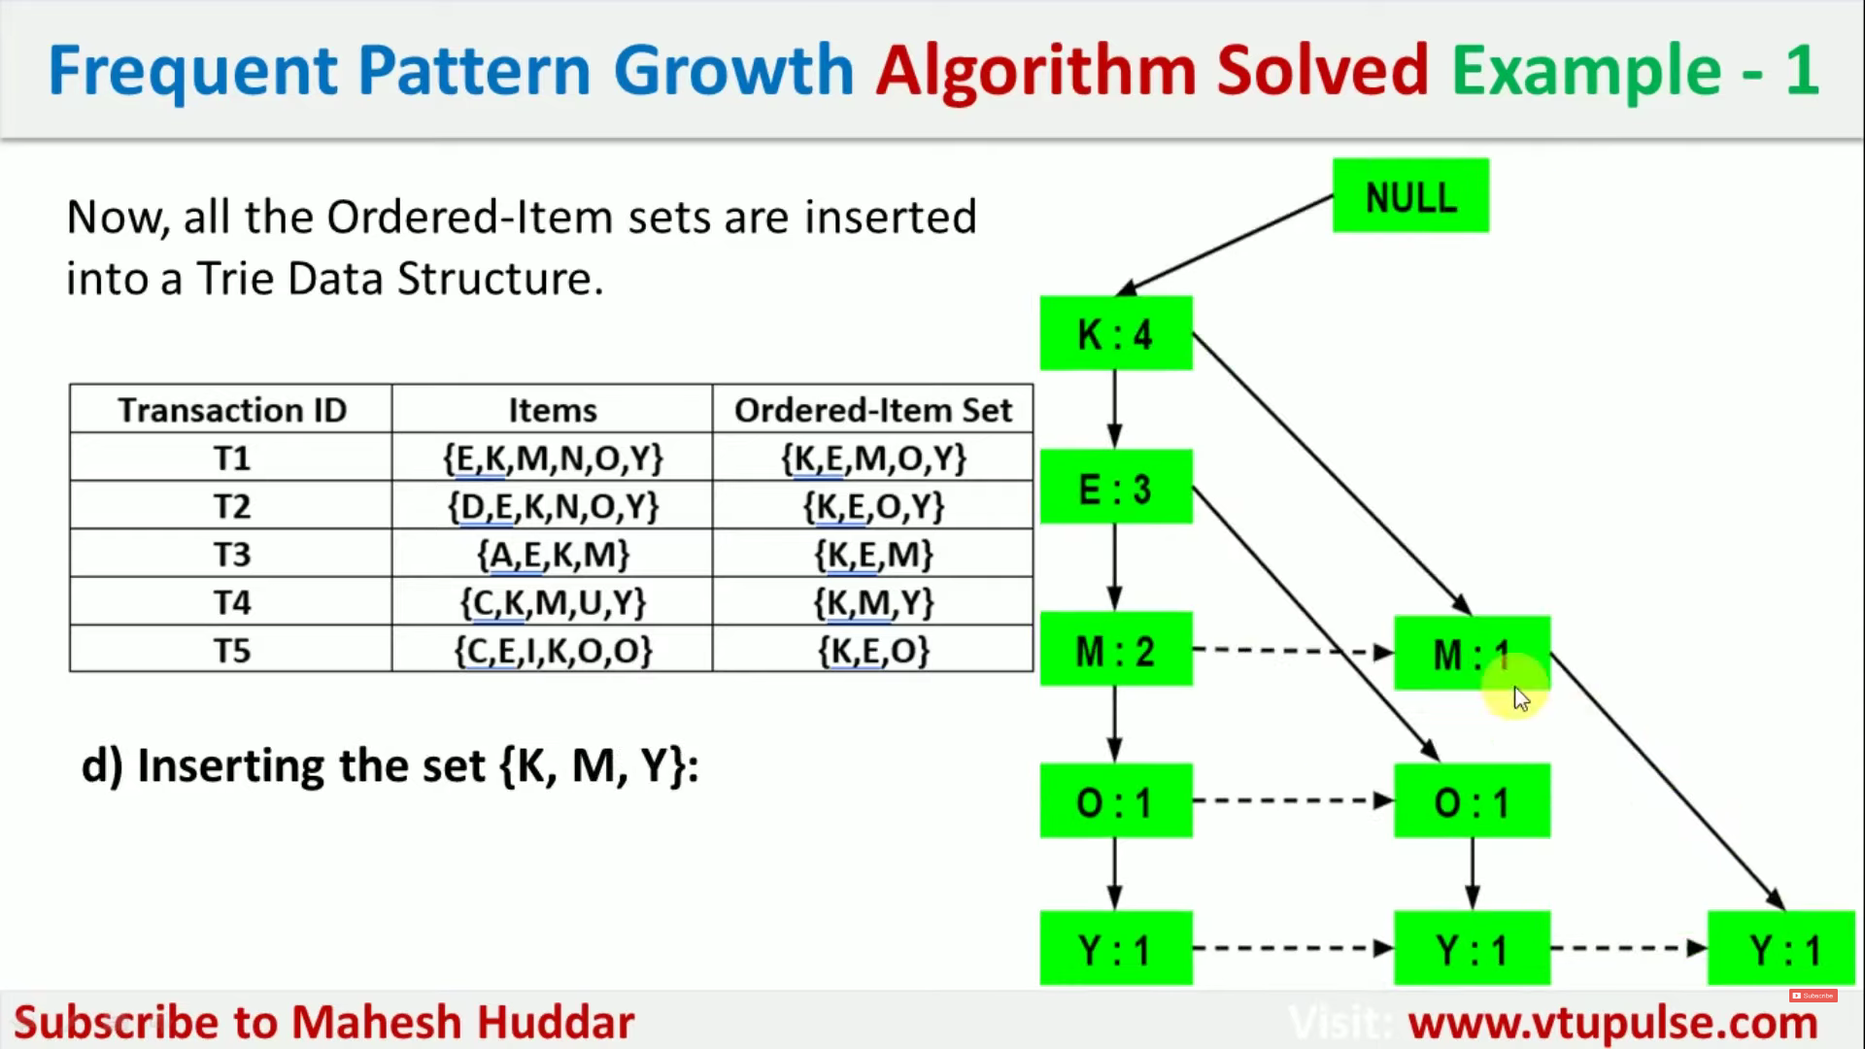

Slide 31
